Slide 1
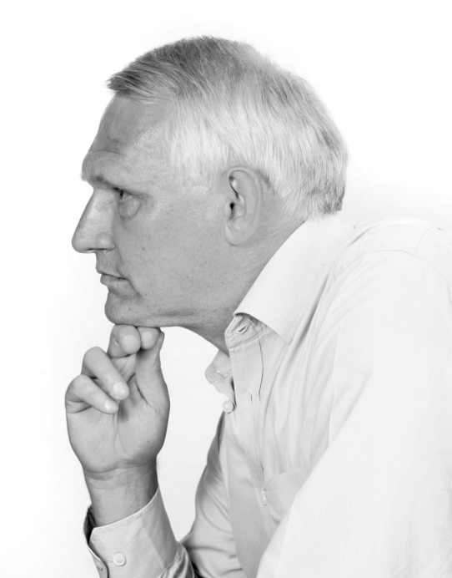
James A Robertson and Associates
Effective Strategic Business Solutions
Organizing Outlook
How to make Outlook into a POWERFUL correspondence management tool
Dr James Robertson PrEng -- The ERP Doctor
Copyright 2013 James@JamesARobertson.com
Notes:
NB remember to have a chair to stand on
Make sure to take the CRITICAL FACTORS BOOK with you
An engineer with a PhD in engineering

Slide 2
Agenda
Organizing Outlook
Basic Principles and Techniques
What these Techniques enable
More Advanced Techniques
Greater Sophistication – when you have a LOT on the go

Slide 3
Agenda
Organizing Outlook
Basic Principles and Techniques

Slide 4
Organizing information –
Cognitive Span – 7 plus or minus 2
Must be easy to grasp
Average person can instantly scan and engage with a list of about 5, few can manage more than 9 items
If work with a list every day CAN learn a much more complex list but it is significantly sub-optimal, particularly when others have to use your list
The cognitive span fundamentally drives hierarchy – it is easier to navigate a logically structured hierarchy of 7 +/- 2 than a long list

Slide 5
Critical principle – constraint and opportunity -- cognitive span

Slide 6
Drill down
A function of the content

Slide 7
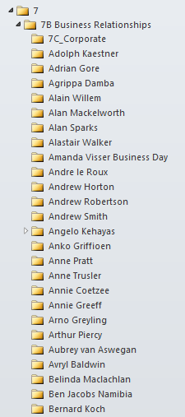
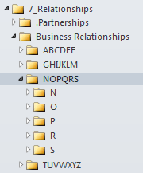
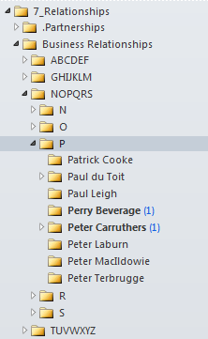
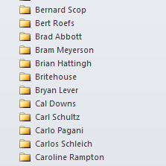
versus

Slide 8
Organizing information –
List prioritization
We naturally engage the top of a list first
Attention dilutes as we work down the list
Put the MOST important categories at the top of the list – different for different organizations and people

Slide 9
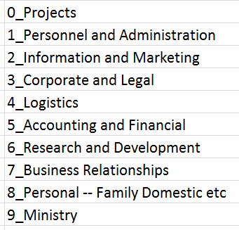
Organizing information –
List prioritization
Example of Inbox Headline Logic and structure – covers everything – in use for 23 years

Slide 10
Organizing information –
Creating the headlines
(and the child items)
Brainstorm a list
Write 1 to 9 in the left hand margin of an A4 sheet
Write down the major categories in YOUR situation or for your organization if you want to develop a broader standard
A set of categories that cover EVERYTHING possible
The things that are most important at the top

Slide 11
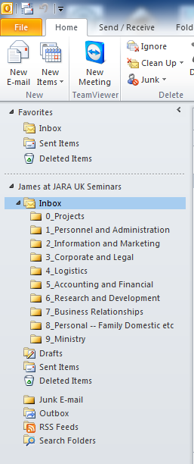

Slide 12
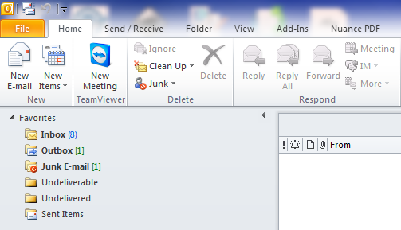
Organizing information –
Organizing your favorites
Inbox, Outbox and selected other folders at the top

Slide 13
Organizing information –
Adding folders
Splitting the Inbox up into folders for different topics
The beginnings of a potentially highly sophisticated and powerful filing system

Slide 14
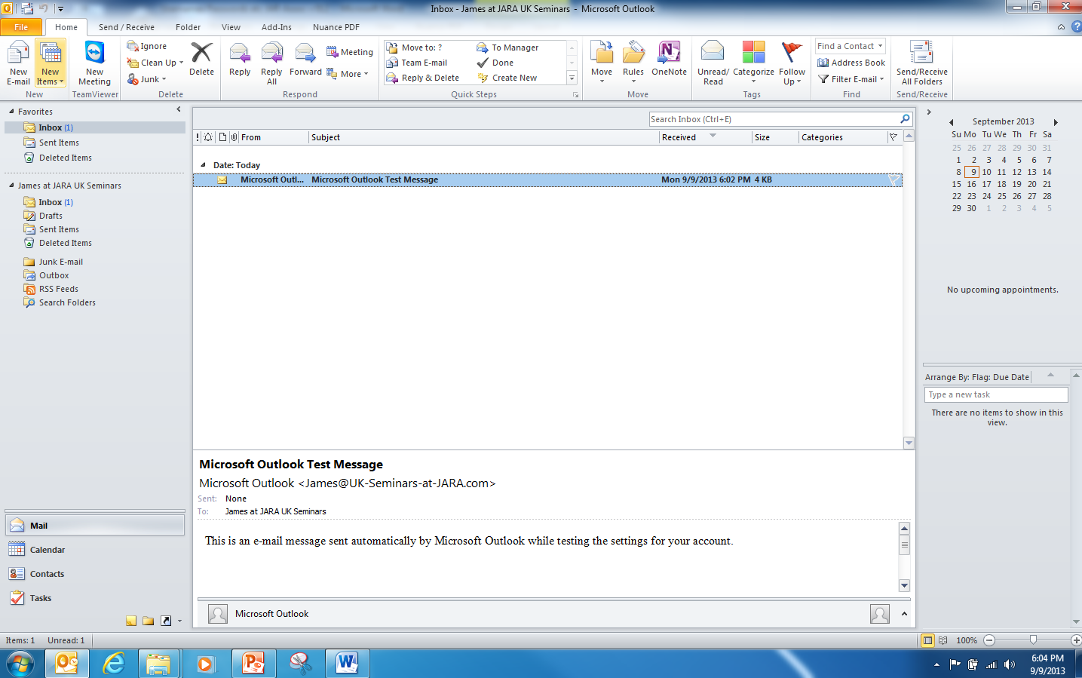

Slide 15
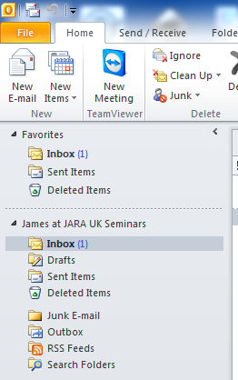
Right Click
New Folder

Slide 16
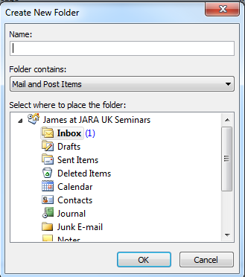

Slide 17
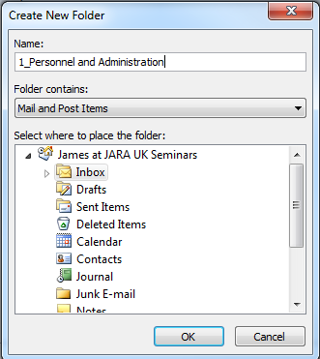

Slide 18
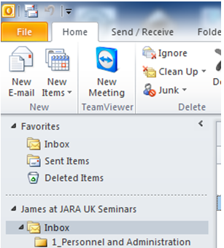
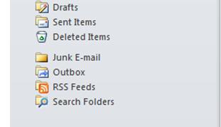

Slide 21
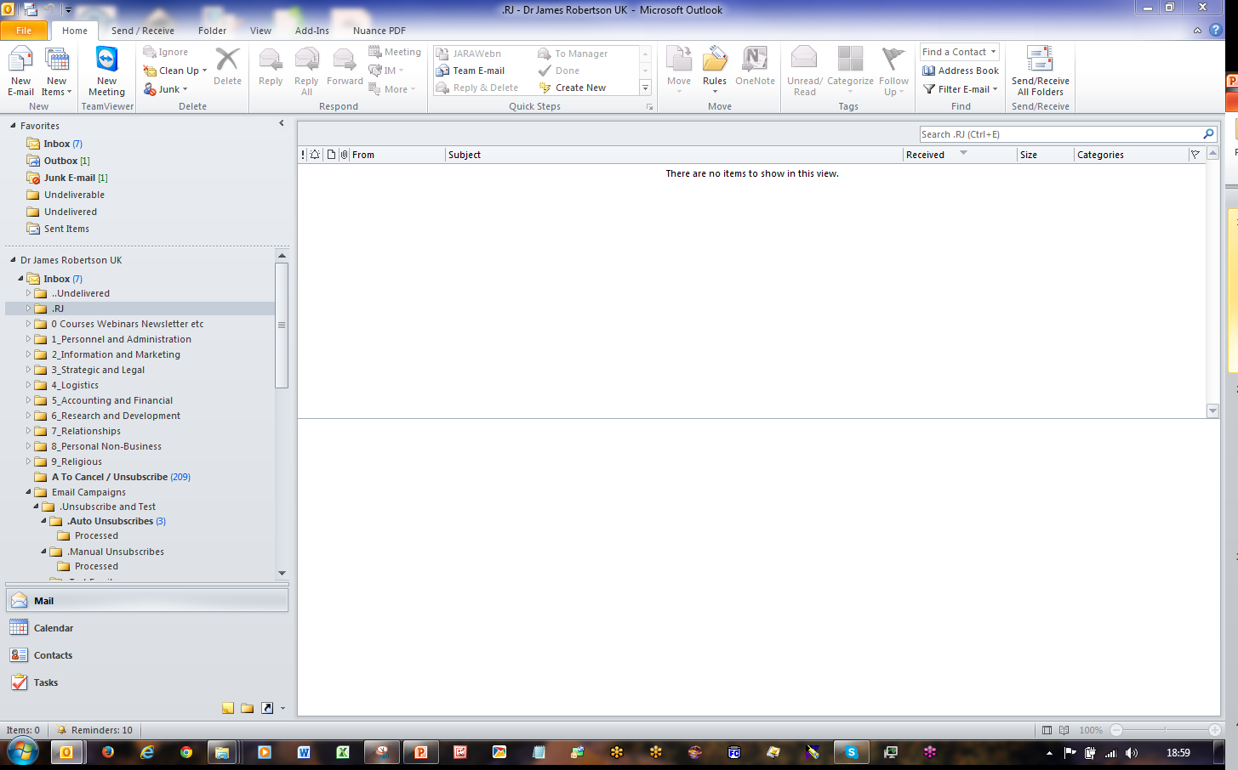
Another example – my actual Inbox – level 1

Slide 22
Organizing information –
Basic Inbox Rules
File automatically based on the origin of the email – sender email address or words in subject line
A simple example
Do this for EVERY email in your top level inbox that you want to keep
Once you have done it once the rule is applied automatically from then on
After a while you will get to the point where your top level inbox contains only new correspondence and junk which you can easily delete

Slide 23
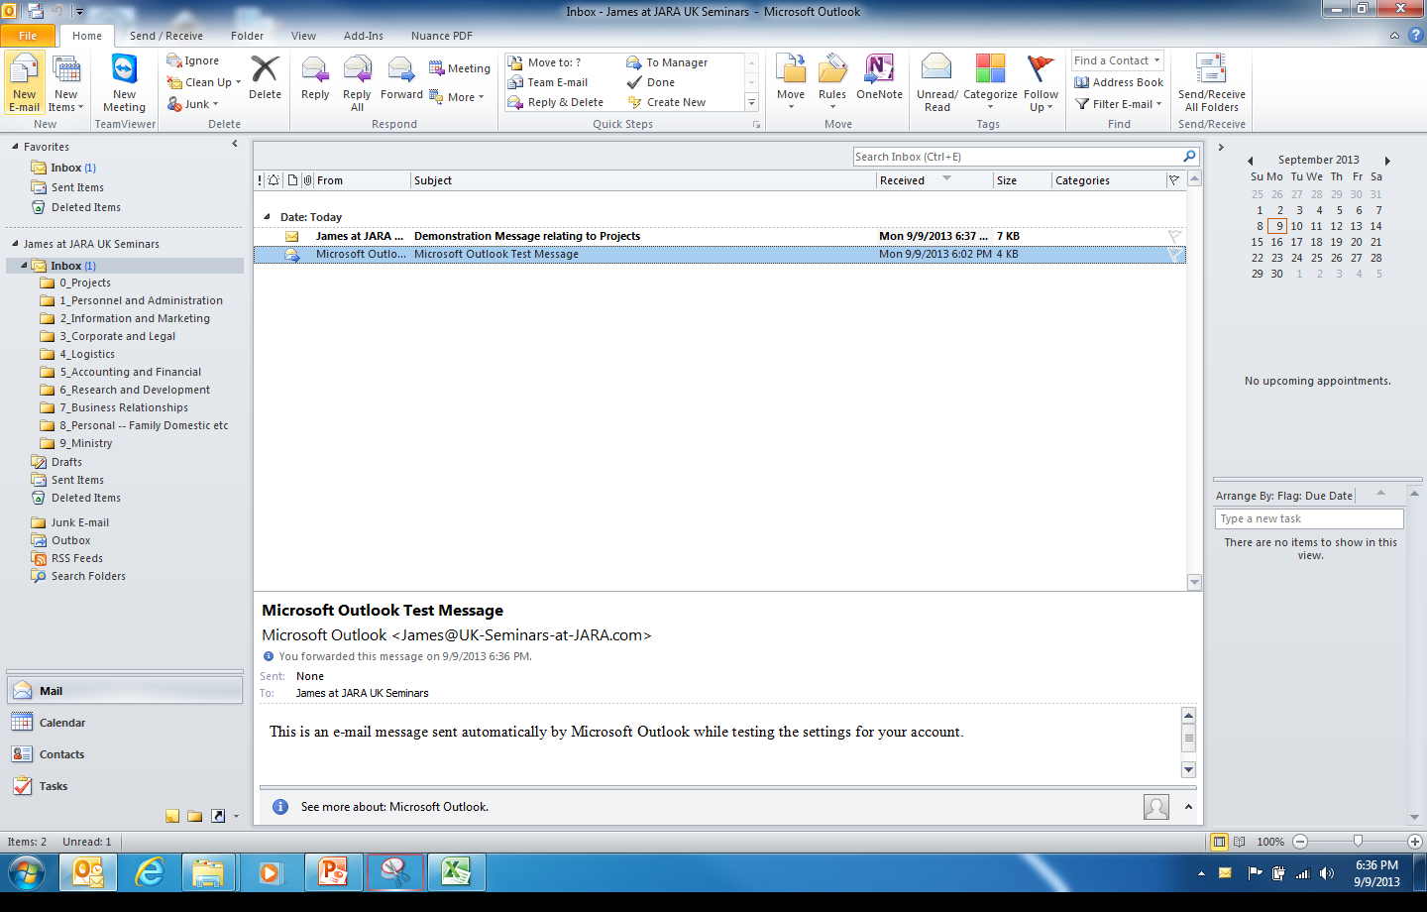

Slide 24
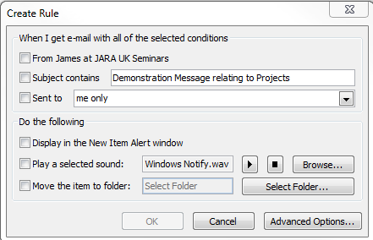
Rules
Create Rule

Slide 25
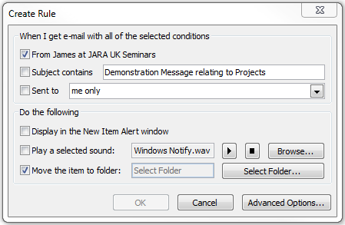

Slide 26
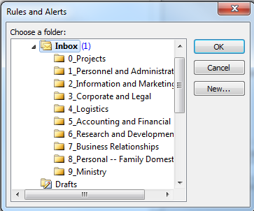

Slide 27
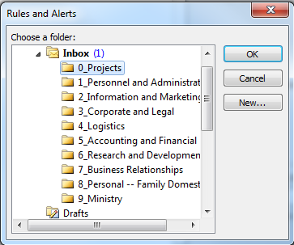
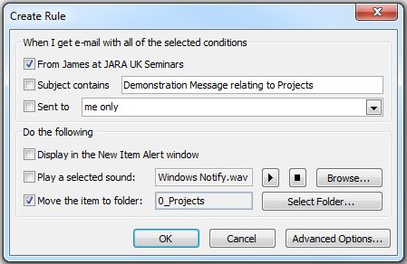

Slide 28
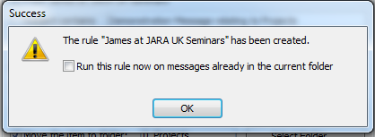

Slide 30
Organizing information –
Associating emails out with emails in
Set-up

Slide 31
Organizing information –
Associating emails out with emails in
Adopt conventions to ensure that outgoing emails are always stored with incoming emails
Putting new outgoing emails in the same folder – always reply to an existing email and delete the contents – that way the new email is in the same folder
Create one complete picture

Slide 33
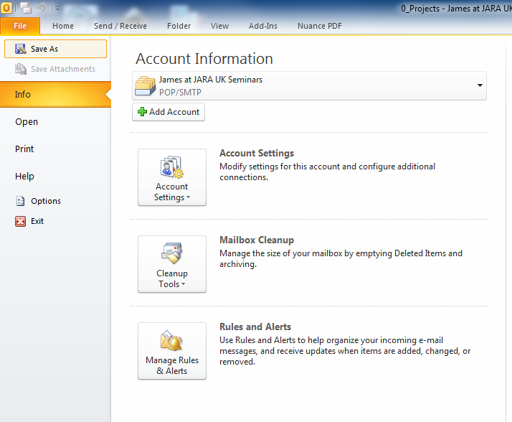

Slide 34
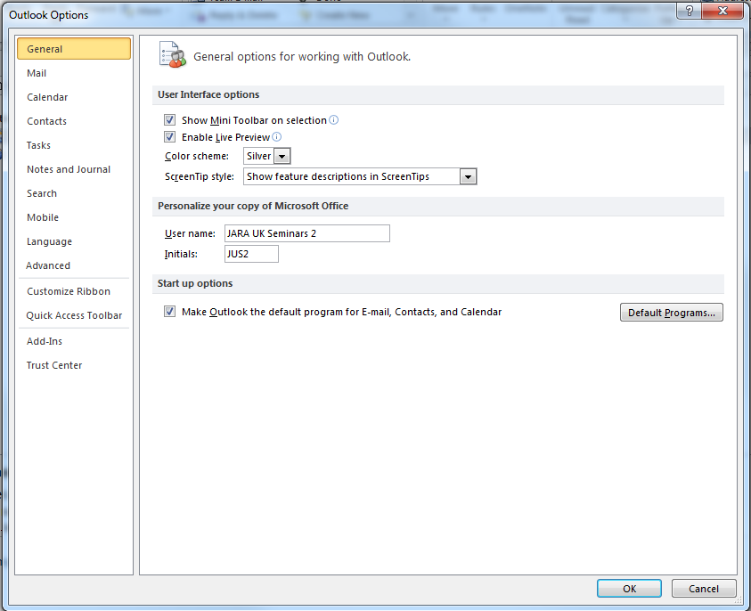

Slide 35
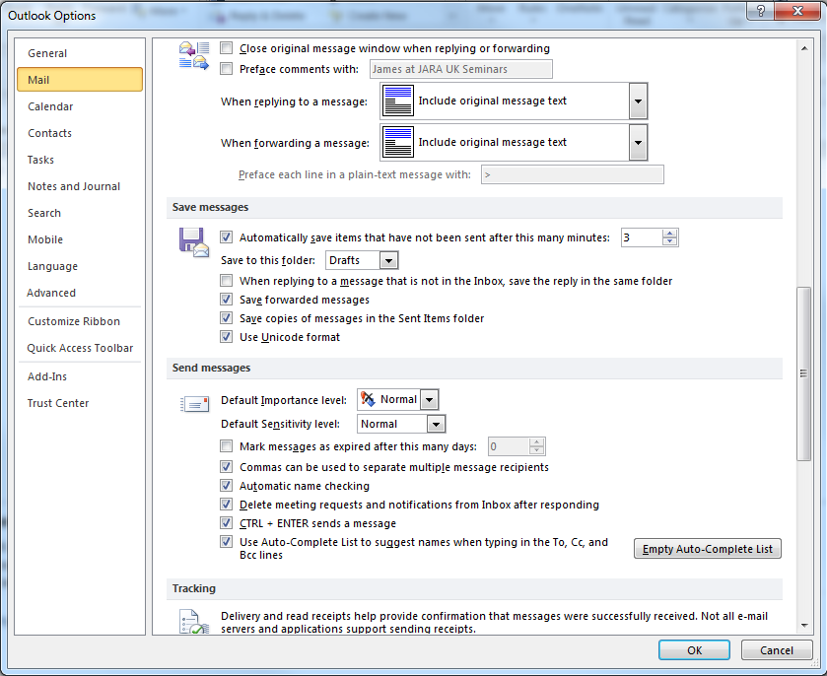

Slide 36
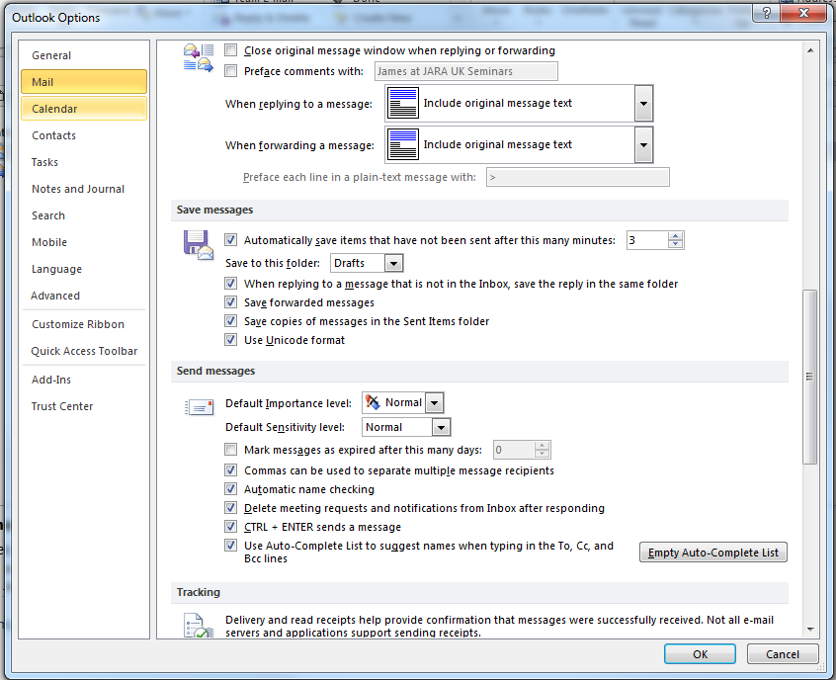

Slide 37
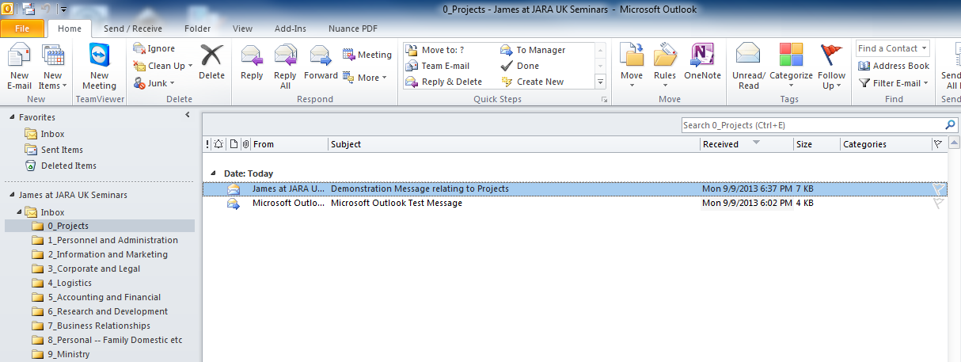
Organizing information –
Associating emails out with emails in
How it works – routine way of working

Slide 38
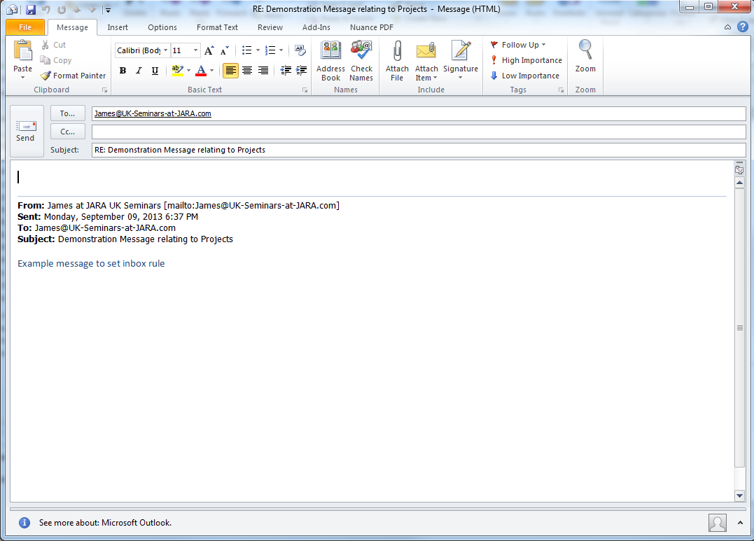

Slide 39
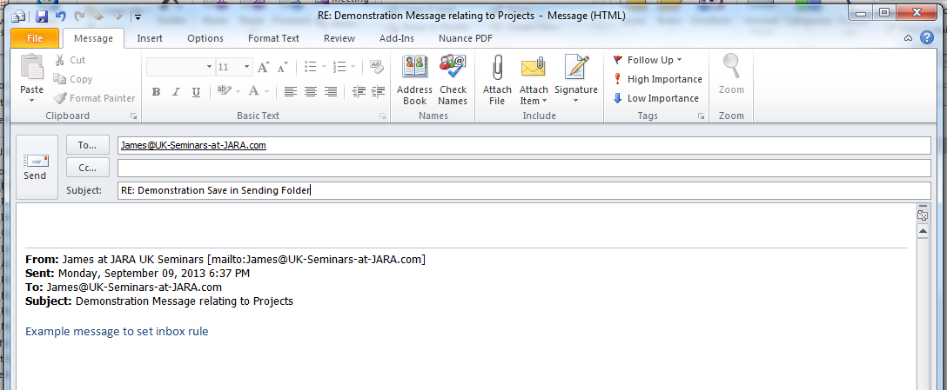

Slide 40
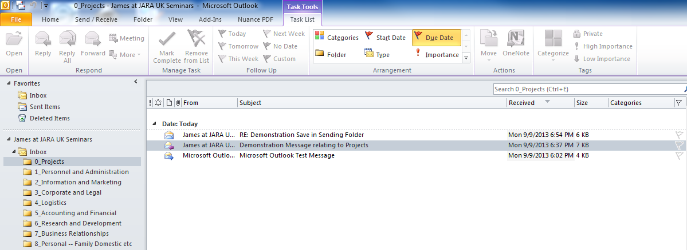
Send

Slide 41
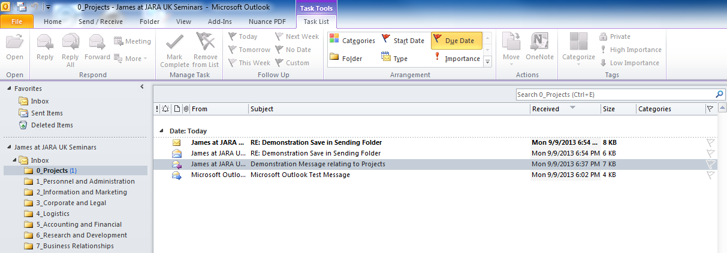
Receive

Slide 42
Agenda
Organizing Outlook
Basic Principles and Techniques
What these Techniques enable

Slide 43
What these techniques enable --
Ease of navigation – go directly to the appropriate folder
Ease of navigation
Know exactly where to find things
Over time you build the hierarchy that works for you
OR you set a corporate standard and invest time in setting up standards for the whole enterprise

Slide 45
Long alphabetic lists -- NOT the right way

Slide 46
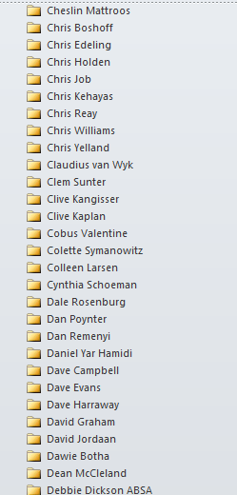
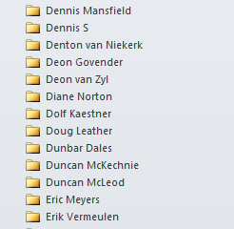
Page down 8 x to find the right folder

Slide 47
What these techniques enable --
Ease of navigation

Slide 50
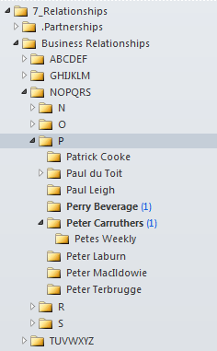

Slide 51
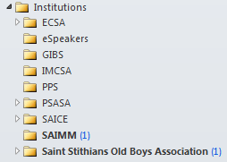

Slide 52
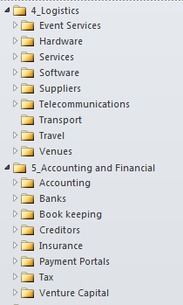

Slide 53
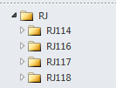

Slide 54
What these techniques enable --
Complete record of ALL correspondence in ONE folder
All emails sent out in designated folder – your discipline
All emails received in same folder – inbox rules
All replies in same folder – automatic
The complete record in ONE place ALWAYS

Slide 55
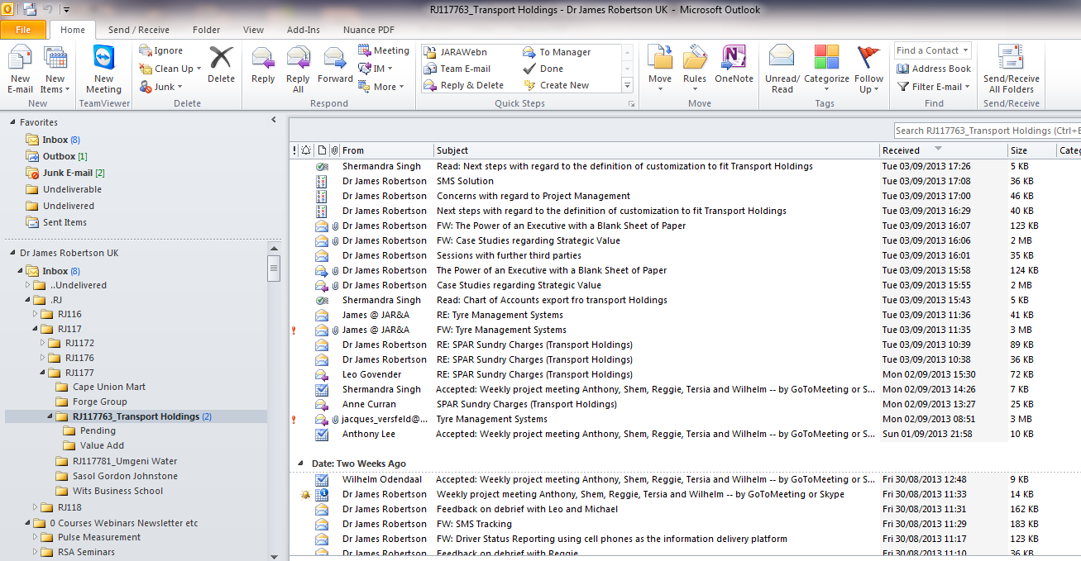

Slide 56
What these techniques enable --
Extracting focused mailing lists
Email addresses in a particular folder relate to a particular topic
Once the hierarchy is right the email addresses in a particular leg of the hierarchy relate to a broader topic or interest and therefore group of people
Tweak Marketing Outlook Address Extractor
Select exactly the folders you want
Extract into Excel, clean as necessary
Separate out first and last name if required
Be aware of cc’s – may be some surprises – may be a bonus in some cases, negative in others
Use with Group Mail or similar for targeted mailings

Slide 57
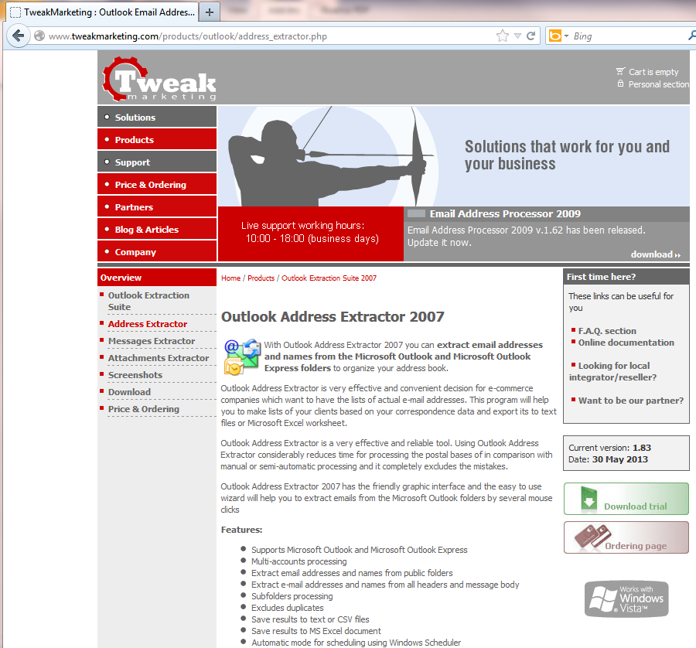
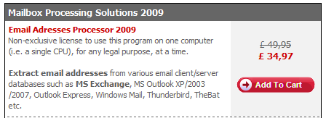

Slide 58
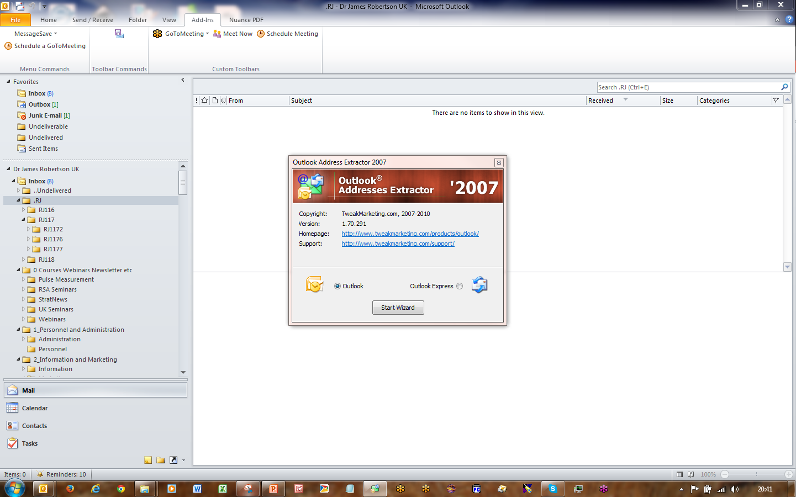
http://www.tweakmarketing.com/products/outlook/address_extractor.php

Slide 59
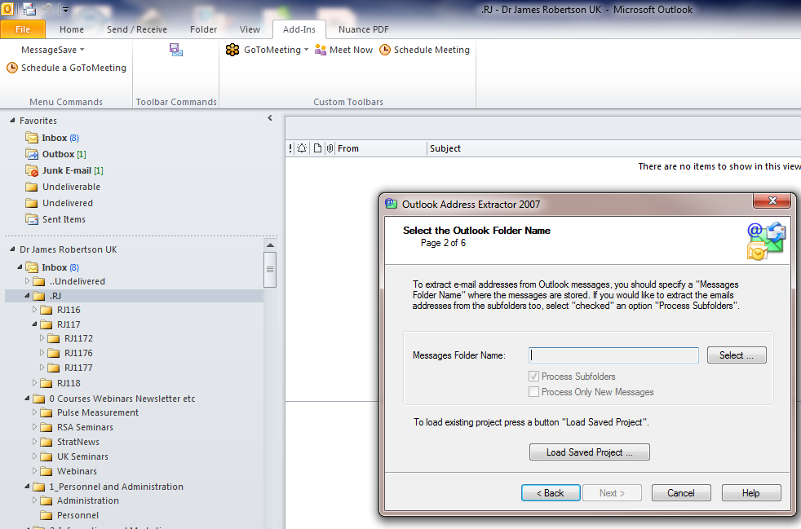

Slide 60
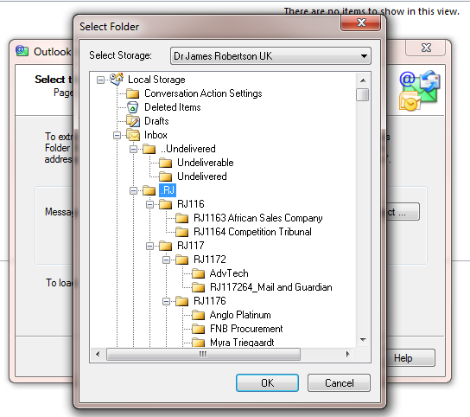

Slide 61
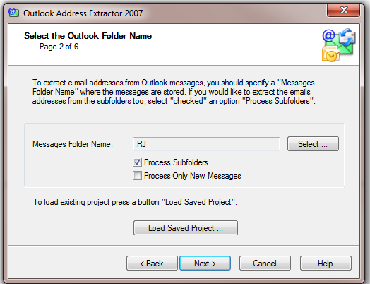

Slide 62
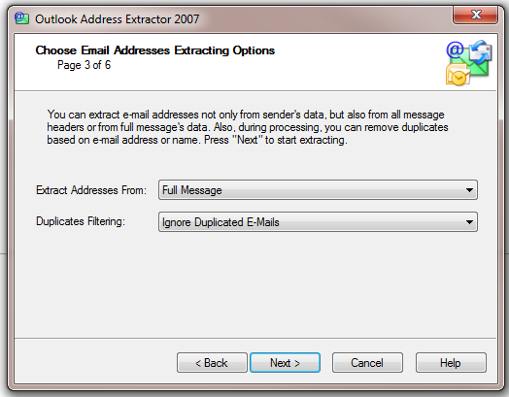
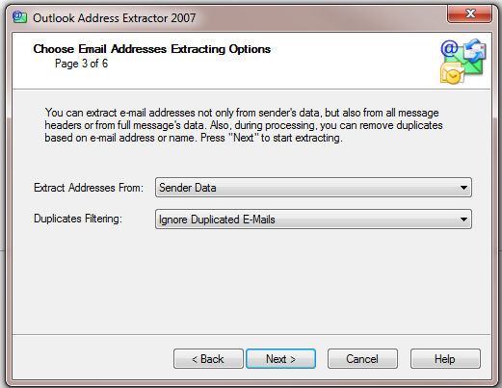
Various Criteria

Slide 63
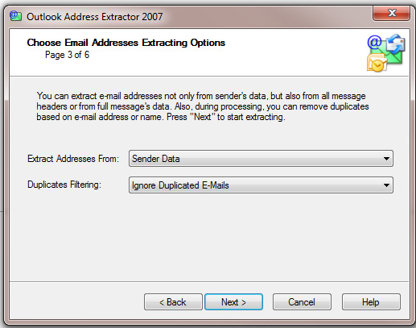

Slide 64
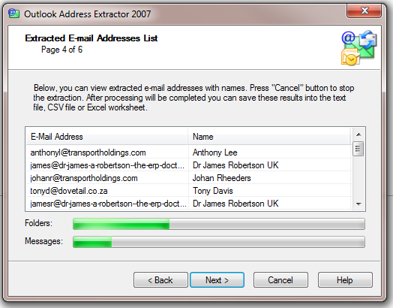

Slide 65
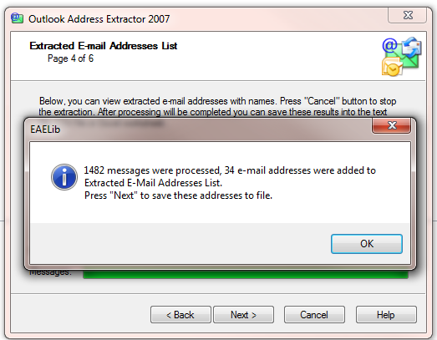

Slide 66
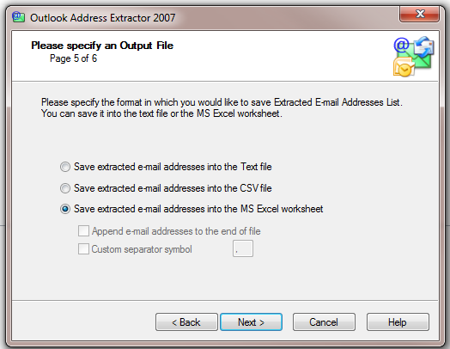

Slide 67
Excel MUST be open
Clean up, delete header and Save As CSV

Slide 68
Import into GroupMail or similar

Slide 69
Agenda
Organizing Outlook
Basic Principles and Techniques
What these Techniques enable
More Advanced Techniques

Slide 70
More advanced techniques
Deeper hierarchies – one topic
7 +/- 2 cascading as required
The more consistent the structure the easier to navigate
Narrow down the scope of any folder – the screws in the hardware store analogy
Separate folders for enduring reference emails
Neatly stored information in large numbers of small well ordered bins

Slide 71
More advanced techniqes –
A more complex example
As you add folders the structure becomes more complex AND more useful
Next level of detail of my own primary Inbox

Slide 74
Project or other numerical sequence information

Slide 76
Completely different structure for email marketing

Slide 77
Another different example – analyzing bounces

Slide 78
More advanced techniques –
More Advanced Inbox Rules
How to have Outlook automatically move an incoming email to the required folder – an automated filing assistant
Based on the origin of the email or words in the subject line or other more sophisticated criteria
A more complex example

Slide 81
Right Click
Rules
Create Rule

Slide 93
More advanced techniques
Export to your local hard drive
TechHit Message Save – store as Outlook “.msg” on your local drive
Careful selection and testing of settings
Hierarchy is maintained on your hard drive
Can find emails years later, even if no longer have them in Outlook
Write to DVD if required

Slide 95
http://www.techhit.com/messagesave/

Slide 96
On Inbox, Sent Folder or other selected folder
Save Messages

Slide 97
Settings are important

Slide 99
The resulting folders on my local hard drive

Slide 106
More advanced techniques
More sophisticated inbox rules
Extremely wide range of parameters that can be used
As sophisticated as you can imagine
Need to test carefully, can produce unexpected results and does NOT always work right first time
The creation of inbox rules in Outlook is extremely flexible and extremely powerful
The management of a large number of inbox rules in Oulook IS primitive so think them out carefully and be disciplined when you create them
In my experience the vast majority of inbox rules are based on the email address of the person sending the email to you

Slide 107
Highlight
Right Click
Copy
Highlight
Ctrl C – to copy
OR
Peter Carruthers <editor@petesweekly.com>

Slide 108
Click
Right Click
Rules
Create Rule

Slide 115
Ctrl V

Slide 128
Maintaining Inbox Rules

Slide 131
More advanced techniques
Multiple email addresses
Separate email addresses for different major activities
Allows rules based on the email address to which the email is directed
Projects
Personal / outside interests
Etc
Work through your corporate IT or use a third party service provider like www.Arvixe.com – may need help with set-up
Or a free service like GMail – set-up a little more challenging

Slide 136
Agenda
Organizing Outlook
Basic Principles and Techniques
What these Techniques enable
More Advanced Techniques
Greater Sophistication – when you have a LOT on the go

Slide 137
Greater sophistication
Creating a new Windows User
In order to Archive OR for a new purpose
Keeps your old data and Outlook profile and allows you to start afresh OR start ANOTHER profile
Allows you to have a completely separate Windows set-up for different purposes e.g. one for general business and one for that major project, or personal, or outside interest, etc – all your Microsoft Office settings, most recent files, etc are ALL unique per user
Some limited inconvenience but major advantages if you do it for the right reasons
I prefer to multiple Outlook profiles for one Windows User

Slide 148
Switch User
Logoff

Slide 154
Pin to Taskbar

Slide 165
Greater sophistication
Backing up Outlook locally
Backup Outlook

Slide 167
http://www.backupoutlook.com/
http://www.backupoutlook.com/

Slide 169
Uncheck and recheck the Outlook checkbox

Slide 172
Greater sophistication
Other suggestions
Backup your entire “Documents” or “Data” folder to an external hard drive as a direct copy using “Fast Copy” or similar

Slide 174
Greater sophistication
Fast Copy and further Online Seminar
Attend “organizing your documents” for more hints

Slide 175
Summing Up
Most of these techniques are fairly easy to apply
Require discipline
Out of a clear decision to organize one’s information out of clear understanding that it will add value
A challenge to do at first – learning a new approach
Very substantial long term sustainable benefits if you make the effort
James A Robertson and Associates can assist you to design and implement enterprise solutions incorporating all these principles and techniques

Slide 176
If you do not act within 48 hours you probably never will (Bill Gates)
Act TODAY! ☺
What is your single most important insight from this presentation?
What is the single most practical action that you can take tomorrow to utilize Outlook more effectively?
Please write down your thoughts
NOW
James@JamesARobertson.com

Slide 177
Questions?
We will email you a Drop Box link to the hand-outs and
recording of this presentation
"To Him who by wisdom made the heavens, for His mercy endures forever;"
Dr James Robertson PrEng – The ERP Doctor -- Mobile: +44-(0)-776-862-2875 or +27-(0)83-251-6644
www.JamesARobertsonandAssociates.com
James@JamesARobertson.com
LinkedIn: http://uk.LinkedIn.com/in/DrJamesARobertsonERPDoctor
0
Assisting clients to thrive through the effective application of IT and ERP – high value, high reliability solutions

